Slide 1
컴퓨터 네트워크 Computer Networks and Internets, 6e

Slide 2
PART III Packet Switching and Network Technologies An overview of packet switching and packet technologies that use wired and wireless media
© Pearson Education Inc., Upper Saddle River, NJ. All rights reserved.
2
Notes:
2

Slide 3
Chapter 13 Local Area Networks: Packets, Frames, and Topologies
© Pearson Education Inc., Upper Saddle River, NJ. All rights reserved.
3
Notes:
3

Slide 4
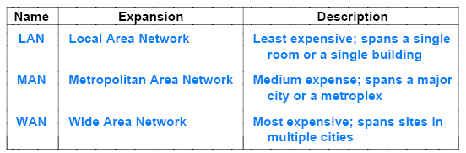
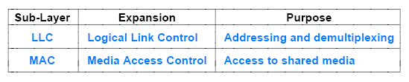
Review
Packet Switching => Netwok(LAN) ; shared media
LAN standard
Network topology (shape)

Slide 5
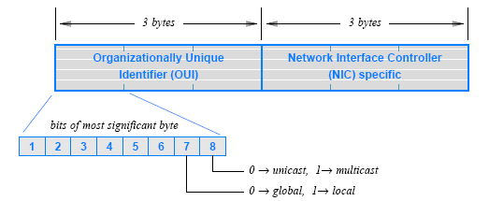
IEEE Standard For Addressing
IEEE Media Access Control address(MAC address)
Informally called an Ethernet address
Assigned to Network Interface Card (NIC)
there is a 3-byte Organizationally Unique ID (OUI)
OUI identifies the equipment vendor
a 3-byte block that identifies a particular NIC
© Pearson Education Inc., Upper Saddle River, NJ. All rights reserved.
5
Notes:
5

Slide 6
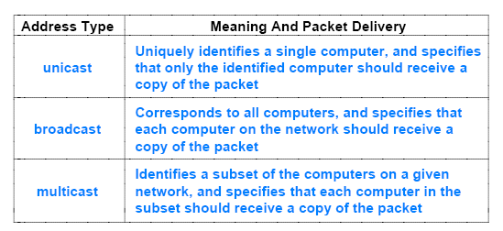
13.10 Unicast, Broadcast, and Multicast Addresses
The IEEE addressing supports three types of addresses
that correspond to three types of packet delivery
Figure 13.9 (below) provides a summary
© Pearson Education Inc., Upper Saddle River, NJ. All rights reserved.
6
Notes:
6

Slide 7
13.12 Frames and Framing
the concept of framing
in synchronous communication systems it is used as a mechanism that allows a receiver to know where a message begins and ends
In more general terms, framing refers to the structure added to a sequence of bits or bytes that allows a sender and receiver to agree on the exact format of the message
In a packet-switched network, each frame corresponds to a packet
A frame consists of two conceptual parts:
Header that contains metadata, such as an address
contains information used to process the frame
Payload that contains the data being sent
contains the message being sent
and is usually much larger than the frame header
© Pearson Education Inc., Upper Saddle River, NJ. All rights reserved.
7
Notes:
7

Slide 8
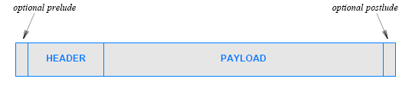
13.12 Frames and Framing
Circuit hardware(leased circuit) either provides a stream of bits or a stream of bytes (characters)
Sender and receiver must agree on framing
SOH, EOT
© Pearson Education Inc., Upper Saddle River, NJ. All rights reserved.
8
Notes:
8

Slide 9
Chapter 14 The IEEE MAC Sub-Layer

Slide 10
MAC Protocols
Control access to shared medium
Two types of channel allocation
Static
Dynamic
General principle: Static channel allocation suffices when the set of communicating entities is known in advance and does not change; most networks require a form of dynamic channel allocation.

Slide 11
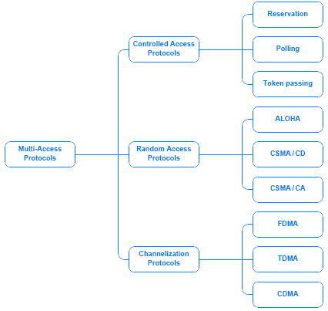
Fig. 14.1
A Taxonomy of Mechanisms for Multi-Access

Slide 12
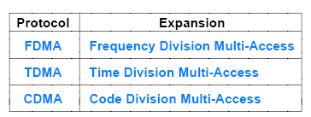
14.4 Channelization Protocols
Channelization protocols extend the multiplexing techniques
May be static or dynamic

Slide 13
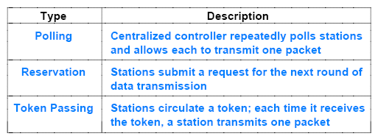
14.5 Controlled Access Protocols
Controlled access protocols provide a distributed version of statistical multiplexing
All three have been used in practice

Slide 14
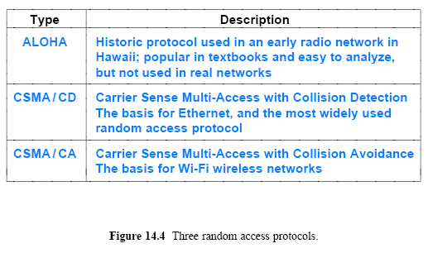
14.6 Random Access Protocols

Slide 15
CSMA/CD
Used in original Ethernet (1973)
Provides access to shared medium
Principle features
Carrier Sense (CS)
Multiple Access (MA)
Collision Detection (CD)
Uses binary exponential backoff

Slide 16
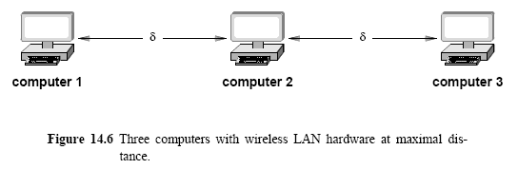
14.6 Random Access Protocols 14.6.3 CSMA/CA
CSMA/CD does not work as well in wireless LANs (Wi-Fi)
because a transmitter used in a wireless LAN has a limited range
A receiver that is more δ than away from the transmitter
will not receive a signal, and will not be able to detect a carrier
Consider three computers with wireless LAN hardware positioned as Figure 14.6 (below) illustrates

Slide 17
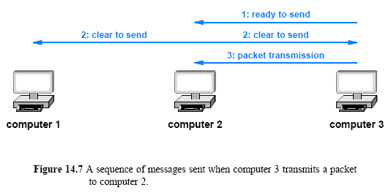
14.6 Random Access Protocols 14.6.3 CSMA/CA
The idea is that if both the sender and receiver transmit a message
all computers within range of either will know a packet transmission is beginning
Figure 14.7 (below) illustrates the sequence

Slide 18
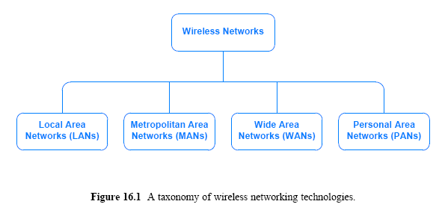
Wireless Networks

Slide 19
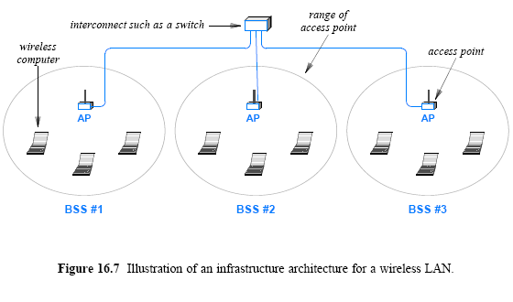
Wireless LAN
- Ad hoc
- Infrastructure

Slide 20
Wireless PAN
Type | Purpose
Blutooth | Communication over a short distance between a small peripheral device such as a headset or mouse and a system such as a cell phone or a computer
Infrared | Line-of-sight communication between a small device, often a hand-held controller, and a nearby system such as a computer or entertainment center
ZigBee | Communication over distances about as large as a residence, which allows electrical appliances to connect to the Smart Grid
ISM wireless | Communication using frequencies set aside for industrial, Scientific, and Medical devices, an environment where electromagnetic interference may be present

Slide 21
Wireless MAN
802.16 : Broadband Wireless Access
Wimax (World-wide Interoperability for Microwave Access)
802.16e => Wibro (Mobile + Wimax)

Slide 22
Wireless WAN
Wireless WAN technologies can be divided into two categories:
Cellular communication systems
Satellite communication systems

Slide 23
Chapter 15 Wired LAN Technology (Ethernet and 802.3)
© Pearson Education Inc., Upper Saddle River, NJ. All rights reserved.
23
Notes:
23

Slide 24
Wired LAN Technologie
Explosion of technologies and products during 1980s
Consolidation during the 1990s
Currently: one de facto wired LAN standard : Ethernet
Invented at Xerox PARC in 1973
Standardized by Digital, Intel, and Xerox (DIX) in 1978
Although the hardware devices, cabling, and media used with Ethernet have changed dramatically
many of the fundamentals remain constant
One of the most interesting aspects of Ethernet evolution concerns the way newer versions of Ethernet remain backward compatible
© Pearson Education Inc., Upper Saddle River, NJ. All rights reserved.
24
Notes:
24

Slide 25
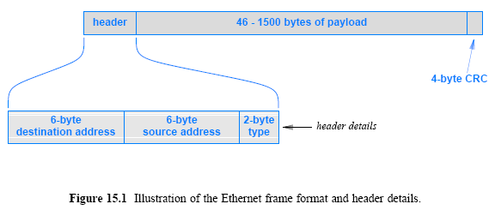
15.3 Ethernet Frame Format
As the figure shows
an Ethernet frame consists of a fixed-length header
a variable-length payload, and a fixed-length CRC
The main reason that older versions of Ethernet have remained compatible with newer versions
arises from the frame format, which has remained constant
© Pearson Education Inc., Upper Saddle River, NJ. All rights reserved.
25
Notes:
25

Slide 26
Ethernet Address Filtering
Recall: station accepts a copy of the frame if destination address matches
The station’s unicast address
The broadcast address (all 1s)
A multicast address to which station is listening
Other frames are ignored
Promiscuous mode allows a station to receive all frames regardless of address
Basis of protocol analyzer software such as Wireshark
© Pearson Education Inc., Upper Saddle River, NJ. All rights reserved.
26
Notes:
26

Slide 27
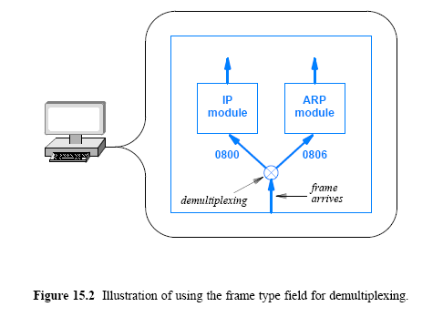
15.4 Ethernet Type Field and Demultiplexing
Performed when frame arrives
Usually handled by protocol software
Frame type field examined and frame passed to appropriate protocol module; unrecognized types are discarded
© Pearson Education Inc., Upper Saddle River, NJ. All rights reserved.
27
Notes:
27

Slide 28
© Pearson Education Inc., Upper Saddle River, NJ. All rights reserved.
28
Notes:
28

Slide 29
© Pearson Education Inc., Upper Saddle River, NJ. All rights reserved.
29
Notes:
29

Slide 30
© Pearson Education Inc., Upper Saddle River, NJ. All rights reserved.
30
Notes:
30

Slide 31
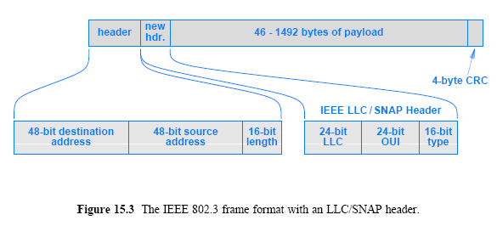
15.5 IEEE's Version of Ethernet (802.3)
Standardized in 1983 as IEEE standard 802.3
Not widely adopted
Header type field reinterpreted as a frame length
Eight bytes of payload occupied by LLC / SNAP header
© Pearson Education Inc., Upper Saddle River, NJ. All rights reserved.
31
Notes:
31

Slide 32
15.6 LAN Connections and Network Interface Cards
NIC appears to be an I/O device
it is connected in the same manner as a disk or video device
A NIC handles
address recognition
CRC computation
frame recognition
sending/receiving frames
A NIC consists of a circuit board with a plug on one side.
Most computers come with a NIC already installed
The NIC is independent from the rest of the computer
and a user can choose to replace the NIC without making other changes
© Pearson Education Inc., Upper Saddle River, NJ. All rights reserved.
32
Notes:
32

Slide 33
Ethernet Wiring
Evolved through three generations
Thicknet
Thinnet
Twisted pair
dIllustrate a range of possible network wiring schemes
© Pearson Education Inc., Upper Saddle River, NJ. All rights reserved.
33
Notes:
33

Slide 34
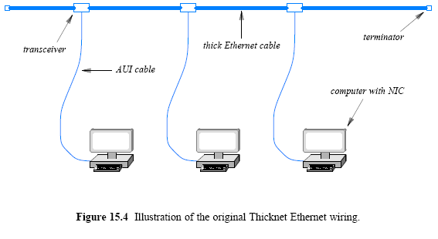
15.7 Ethernet Evolution and Thicknet Wiring
© Pearson Education Inc., Upper Saddle River, NJ. All rights reserved.
34
Notes:
34

Slide 35
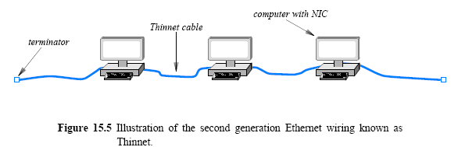
15.8 Thinnet Ethernet Wiring
A second generation of Ethernet used a thinner coaxial cable that was more flexible than Thicknet
Formally named 10Base2 and informally known as Thinwire Ethernet or Thinnet
Thinnet integrates a transceiver directly on the NIC
runs a coaxial cable from one computer to another
Disadvantage: user can disconnect the network
© Pearson Education Inc., Upper Saddle River, NJ. All rights reserved.
35
Notes:
35

Slide 36
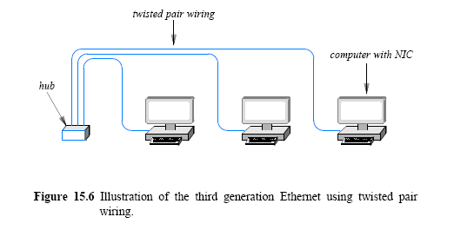
15.9 Twisted Pair Ethernet Wiring and Hubs
Unshielded or shielded twisted pairs using RJ45 connectors
Topology is physical star, but logical bus
Hub is known as “bus in a box”
© Pearson Education Inc., Upper Saddle River, NJ. All rights reserved.
36
Notes:
36

Slide 37
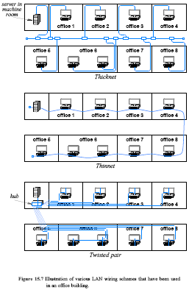
Figure 15.7 Illustration of various LAN wiring schemes that have been used in an office building (Part I)
© Pearson Education Inc., Upper Saddle River, NJ. All rights reserved.
37
Notes:
37

Slide 38
Figure 15.7 Illustration of various LAN wiring schemes that have been used in an office building (Part II)
© Pearson Education Inc., Upper Saddle River, NJ. All rights reserved.
38
Notes:
38

Slide 39
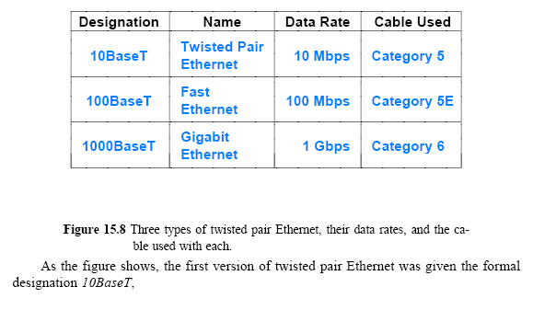
15.12 Variants of Twisted Pair Ethernet and Speeds
© Pearson Education Inc., Upper Saddle River, NJ. All rights reserved.
39
Notes:
39

Slide 40
Assignment
What are the fields in an Ethernet frame? Explain each field(size and content).
An Ethernet MAC sublayer receives 24bytes of data from the upper layer. What is the size of an Ethernet frame containing the data?
Capture Ethernet frames using “Wireshark” and find out the composition of an Ethernet frame.
Send your solution to me by email. (Due date: 4.25. )
This assignment will be used to check your attendance.
© Pearson Education Inc., Upper Saddle River, NJ. All rights reserved.
40
Notes:
40

